Slide 1

VITA San Antonio VITA SA App

Slide 2
Why an App?
Improve client experience
Find a convenient site and view open dates and times
Reduced wait times by getting volunteers to sites that need them
Allow clients to provide feedback
Improve volunteer experience
Visibility to all sites, open dates and times
Simplified logging of hours worked
Allow volunteers to provide feedback
Receive notifications on sites that need help
Improve Site Operations
Make it easy to confirm certification status for volunteers
Encourage volunteers to report hours worked

Slide 3
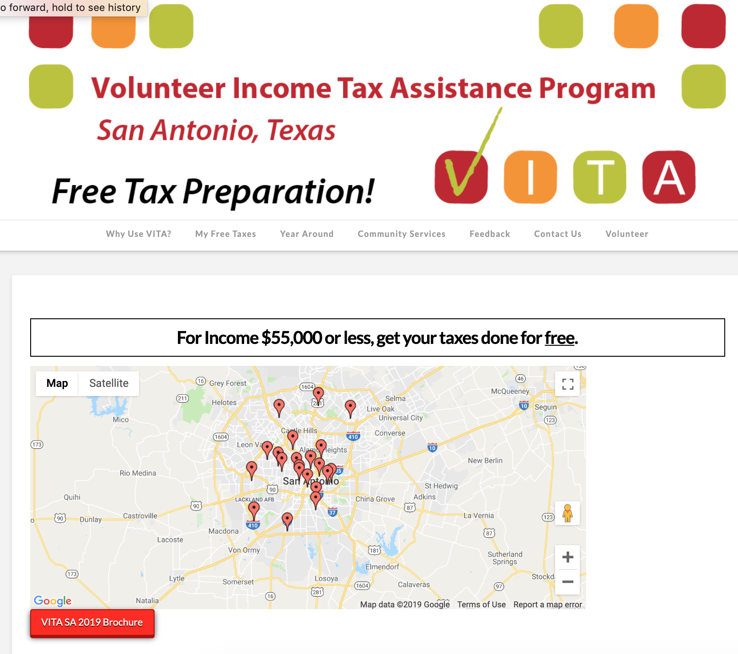
San Antonio App and on the Web
Clients:
Web: vitasa.org
General information on sites, what to bring, etc.
App: for phone & tablet (iOS and Android)
Volunteers
Web: Volunteer-savvy.com
App: for phone & tablet (iOS and Android)
How to get the App
Available in platform App store
Can use either app or web
Zero client information collected

Slide 4
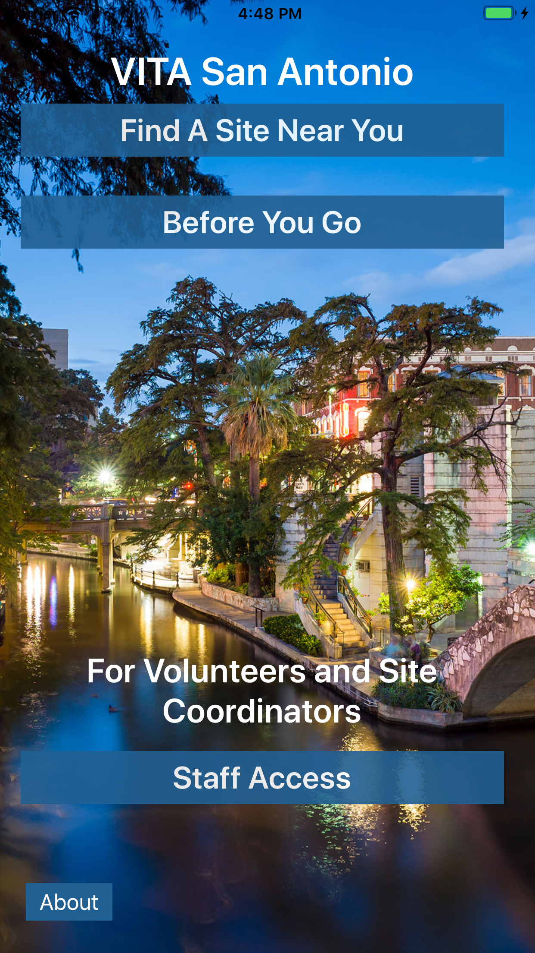
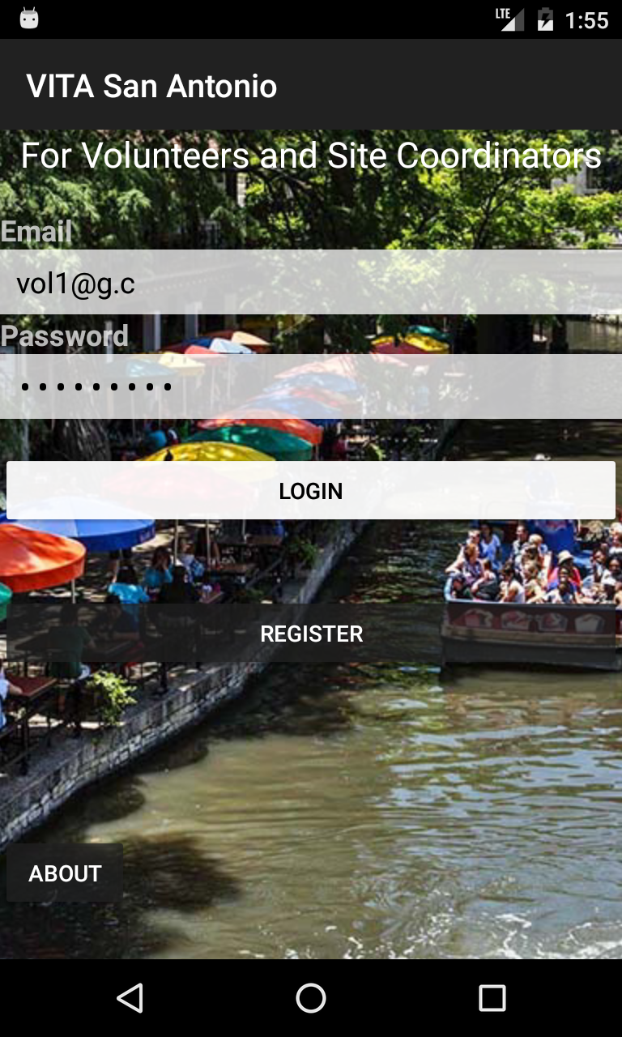
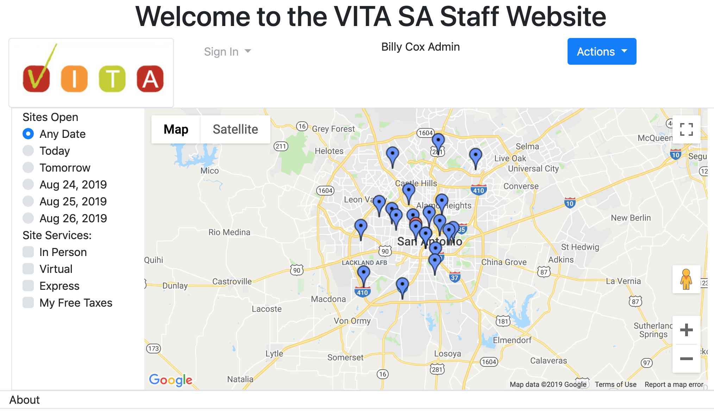
VITA App and Website
Volunteers & Site Coordinators
iOS
Android
Web

Slide 5
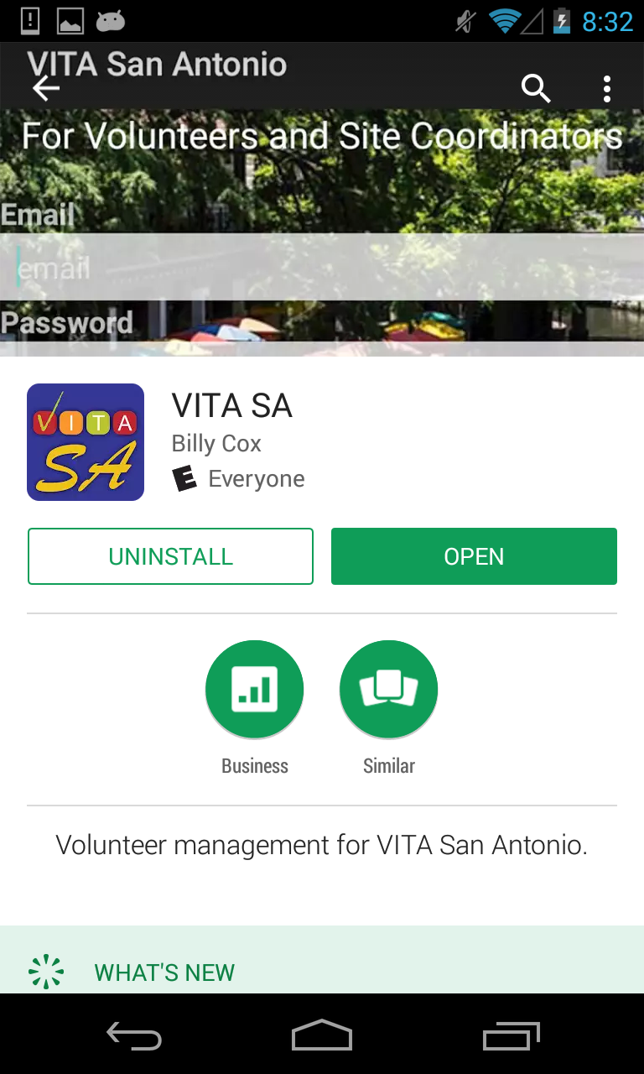

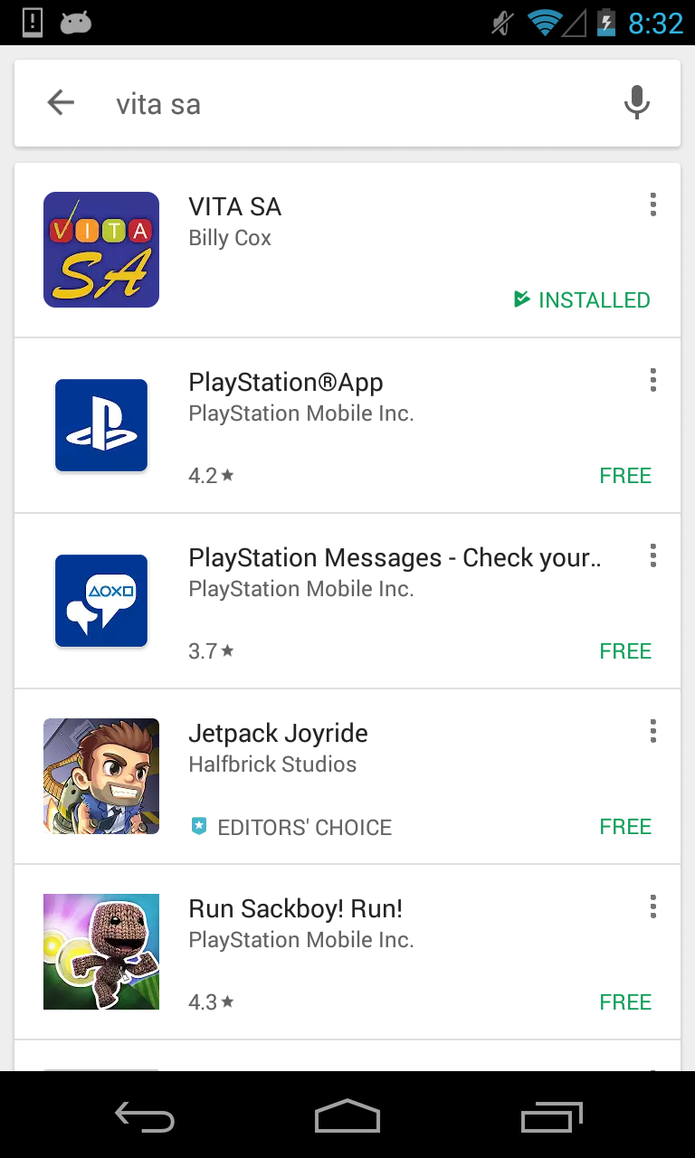
App Installation - Google
Open Google Play Store
Search for “vita sa”
Select VITA SA
Then “Install”

Slide 6

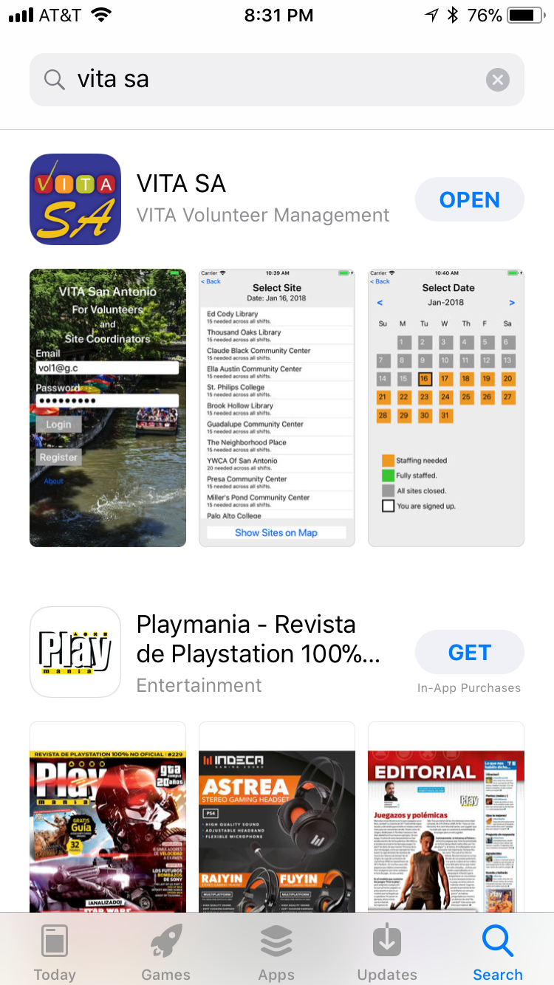
Installation - Apple
Search for “vita sa”
“VITA Volunteer Management”
Touch “Get” (it’s free)

Slide 7
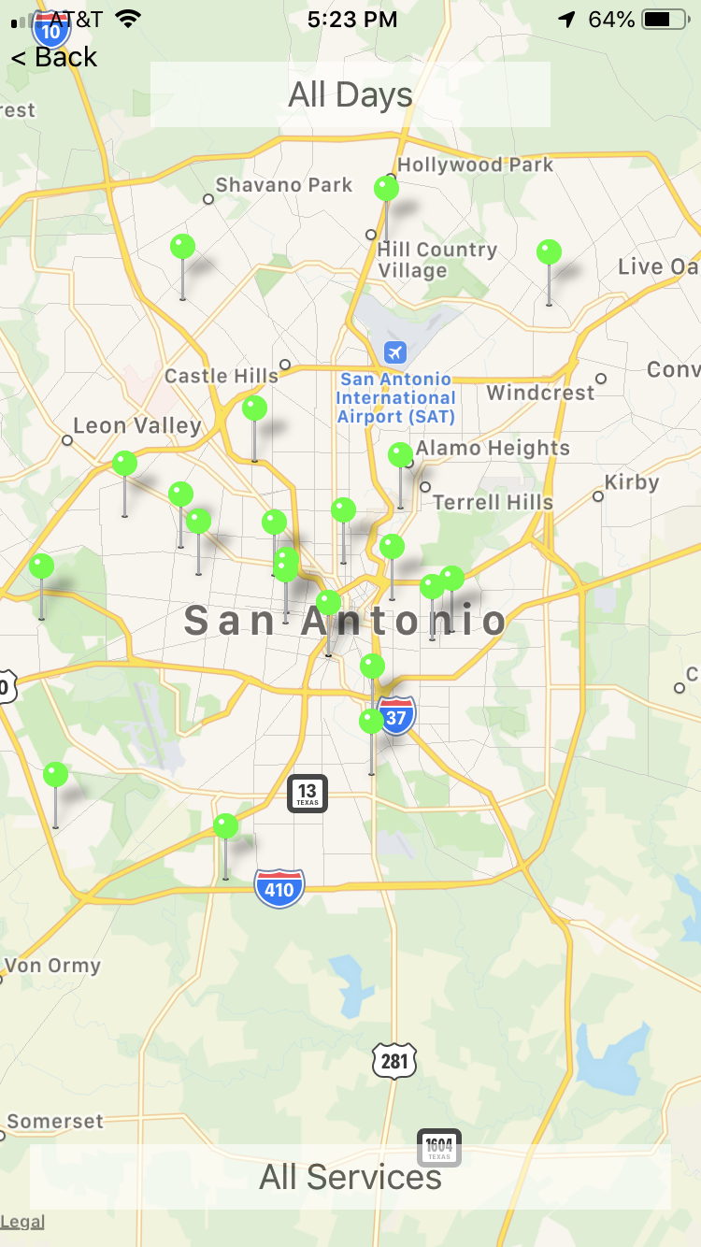
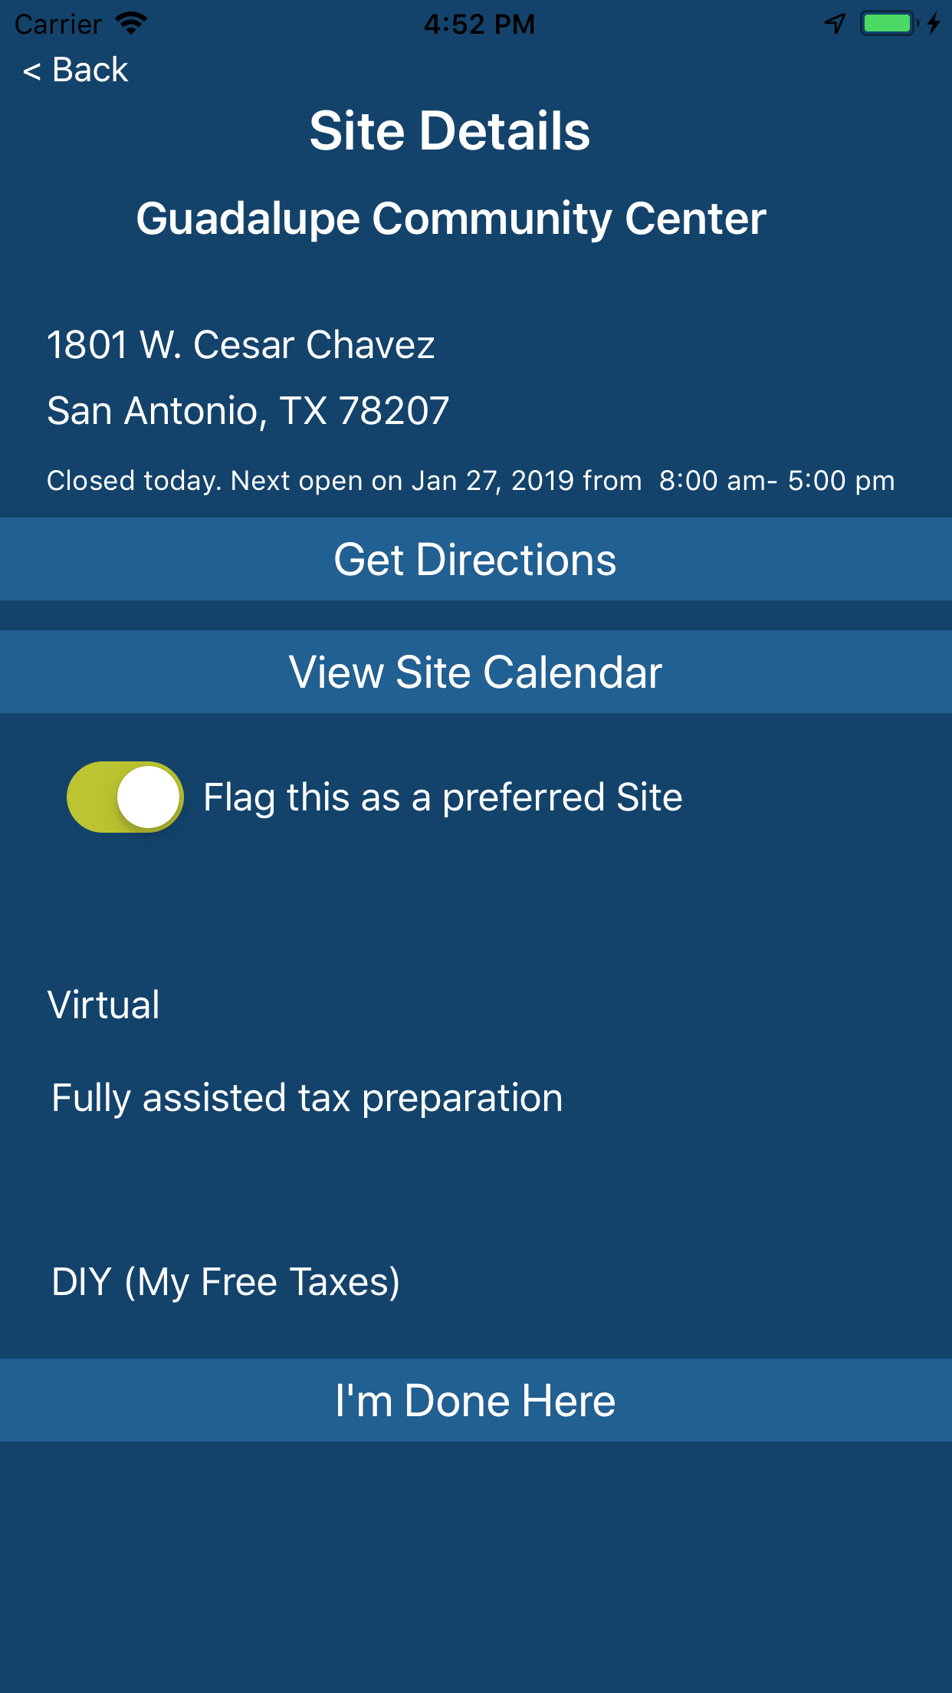
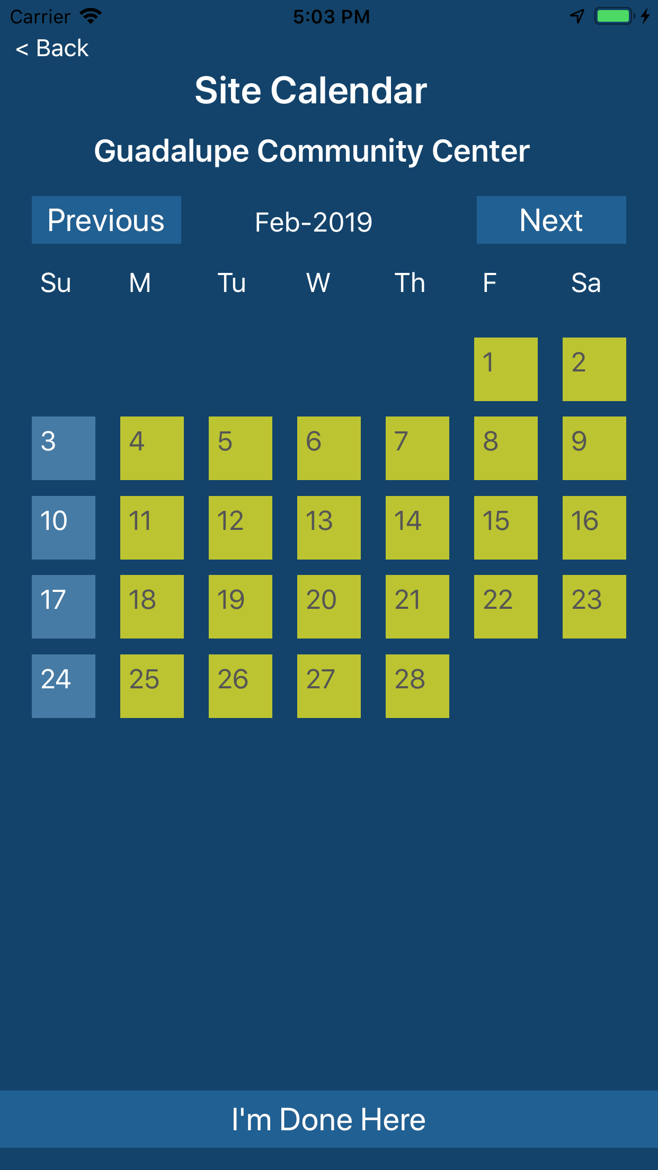
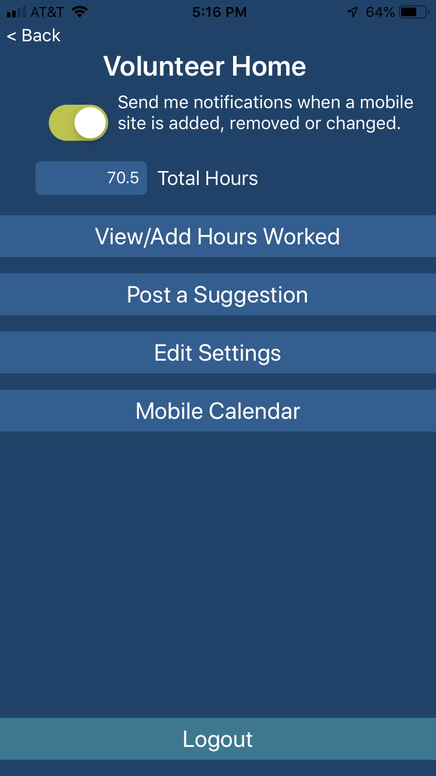
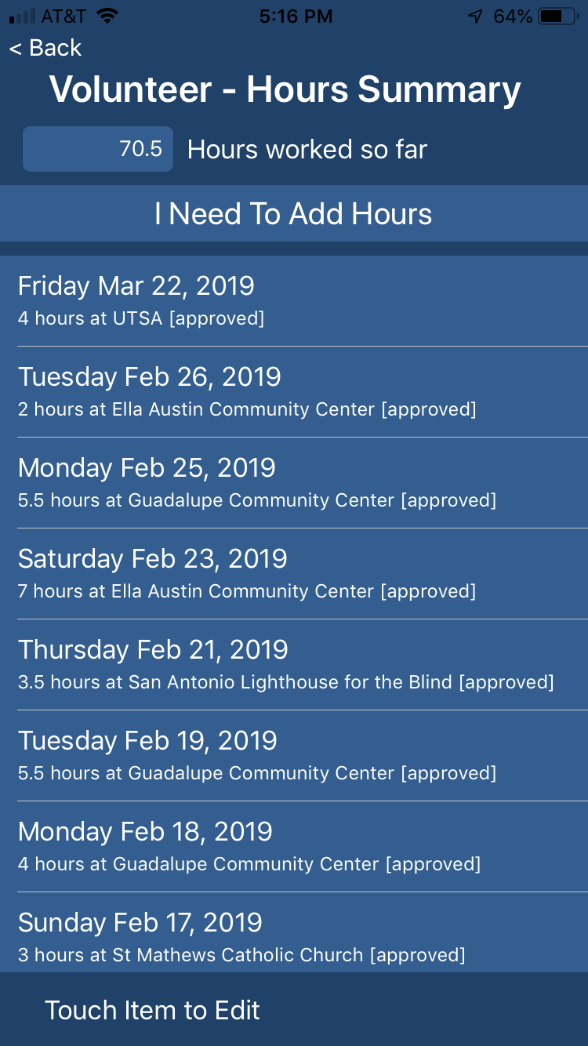
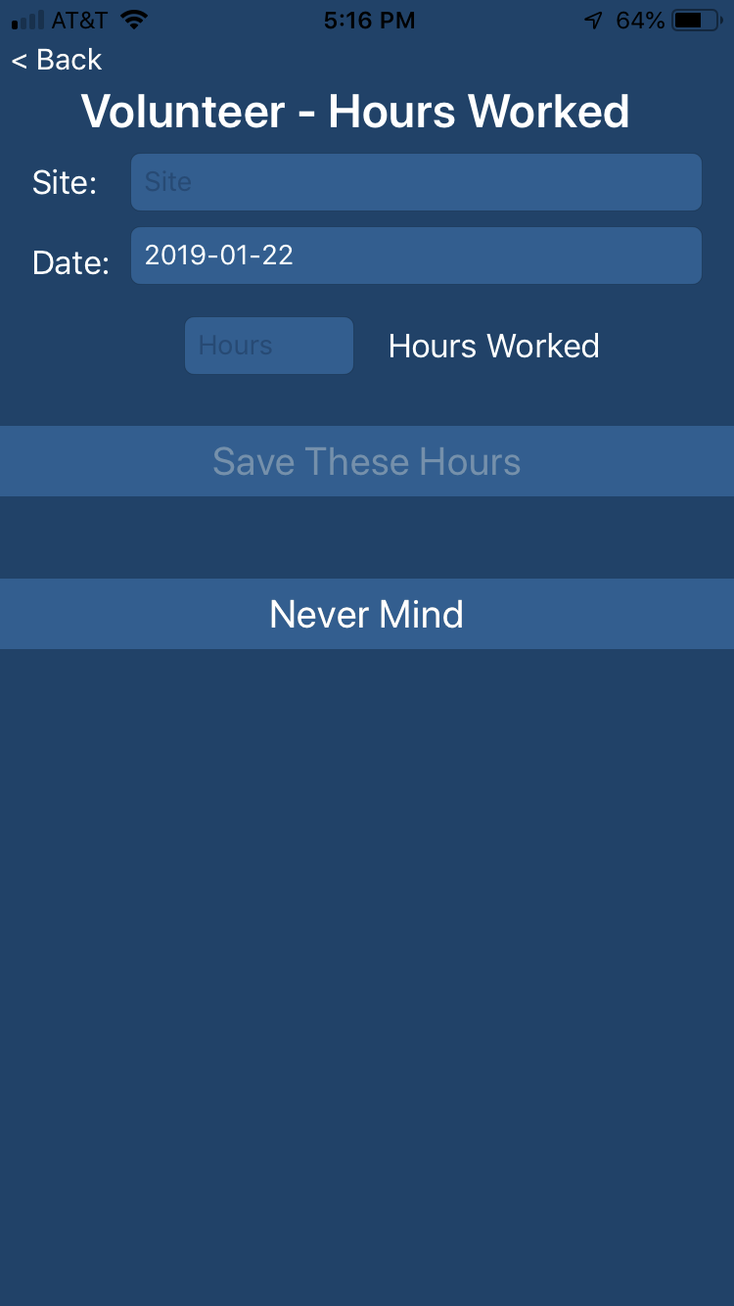
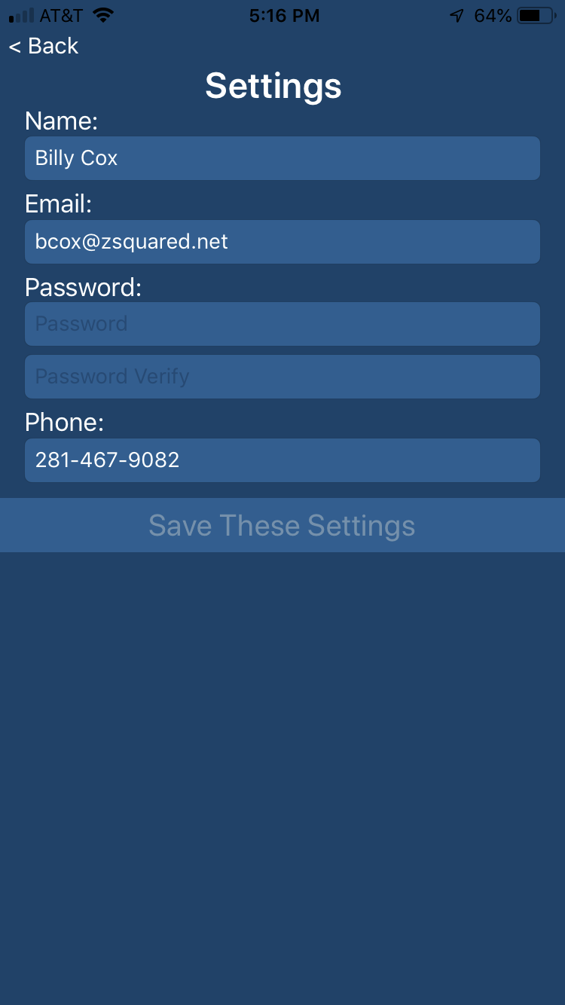
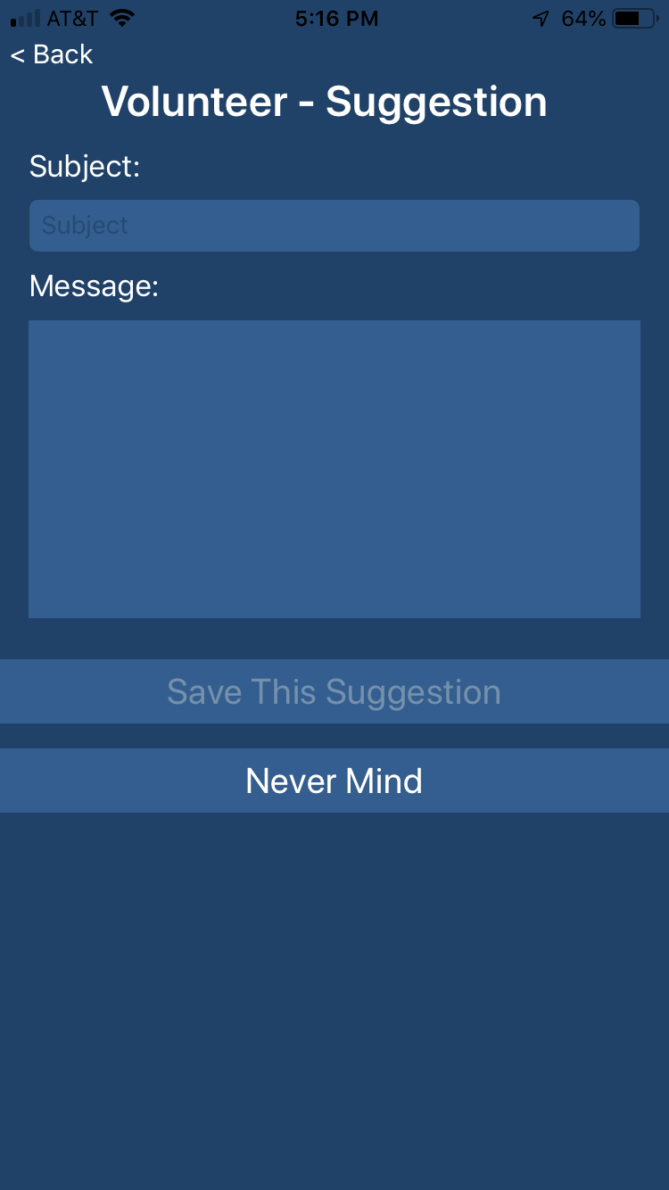
VITA SA App
Receive notifications from volunteer management office on changes to preferred site or general news.
Sites Map
Sites Details
Sites Calendar
Volunteer Home
Volunteer Hours
Volunteer Work Log
Settings
Suggestions

Slide 8
VITA App Operation
Volunteers are entered in the system at the start of training but with no certifications
On successful completion of IRS test, staff updates certifications in volunteer record
Admin staff updates sites along with site calendar (open dates and times) as needed

Slide 9
VITA SA App
Optimize the customer experience by fully utilizing staff, sites, and volunteers.
Encourage volunteers to go to the sites that need help.
(and away from sites that don’t)
For more information:
billy.cox@zsquared.net

